Slide 1
Predicting CKD and Potential Risk Factors with Multiple Linear Regression
Gabriel Goulart, Nicholas Hertle, Lydia Lucchesi

Slide 2
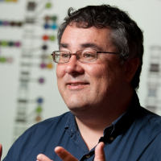
Survey Package in R
Thomas Lumley
Created for complex survey designs
Weighting
https://www.stat.auckland.ac.nz/people/tlum005
Notes:
The complex survey design used to obtain a representative sample of the United states is taken into account each time we run a regression test, a chi-squared test, create a scatterplot, or for example, build a table of totals. Our dataset only has 14000 observed cases of CKD in 2014, but using the survey package, i can determine that 38 million people in the U.S. have CKD. And this is really helpful and powerful.

Slide 3
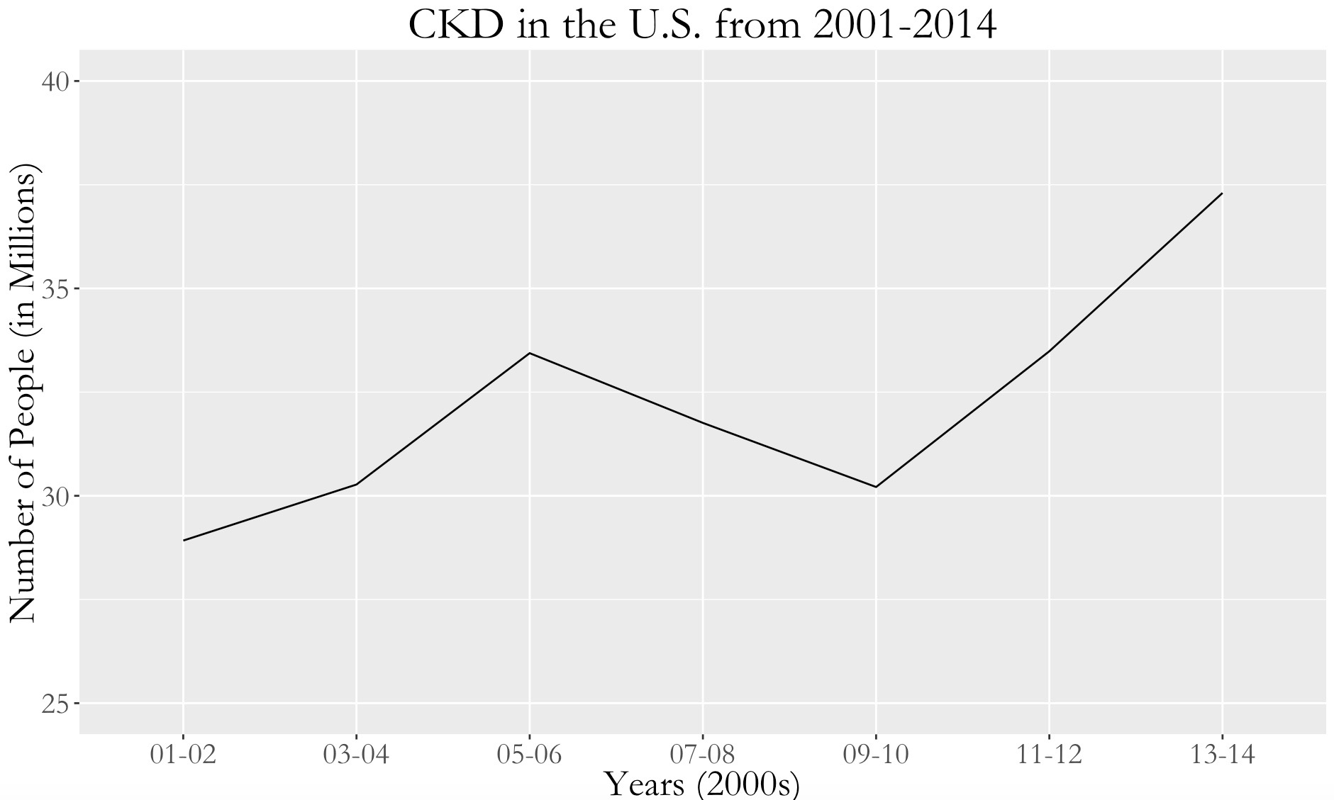
CKD in the U.S.
Clear and
Immediate idea
Notes:
Of what has been and is happening among roughly 300 million people…which is perfect because….

Slide 4
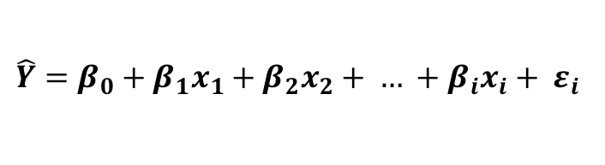
Chosen model (backwards selection):
eGFR ~
$$\hat{Y}=β_{0}+β_{1}x_{1}+β_{2}x_{2}+ … +β_{i}x_{i}+ ε_{i}$$
Notes:
Age groups: 18-39, 40-59, 60+
Races: Mexican, other Hispanic, Non-Hispanic White, Non-Hispanic Black, Other (inc. multi-racial)

Slide 5
Bootstrapping (1000 replicates)
10-Fold cross-validation
renal.org

Slide 6
Importance of Research
This model helps identify what we should focus on in future studies
CKD is becoming more prevalent
Dialysis is difficult and expensive
Notes:
What CAUSES CKD? This type of model helps with more specific future studies to determine the causes of CKD
How can we prevent it? Because it is serious, growing, and expensive. When using something like NHANES, it is all about getting a sense. In order to improve the health of a country, you need to get a strong general sense of its health landscape before you can dive in to all the specifics.

